Slide 1

Vaishnavi Pasalkar
Employee Id-206605
AMDOCS

Slide 2
Table of contents
01
02
03
04
05
06
INTRODUCTION
OBJECTIVES
EXISTING SYSTEM
PROPOSED SYSTEM
IMPLEMENTATION
Conclusions

Slide 3
WHAT IS EMS?
*An Employee Management System (EMS) is a type of software designed to help organizations manage various aspects of their workforce.
*It has been developed to override the problems prevailing in the practicing of manual system.
*It maintains the personal as well as the official details of the employees.

Slide 4
OBJECTIVES
*Project aims to simplify the task of maintaining the records of the employees.
*To develop well designed database connected with MySQL.
*Handles the redundancy of the data and stores in an appropriate format.
*Provides full functional reports to management of Company.

Slide 5
EXISTING SYSTEM
*The records are maintained in registers.
*Time consuming process.
*Complicated searching, editing & updating.

Slide 6
PROPOSED SYSTEM
*Helps in maintaining the computerized employee details.
*Create new users to the system accordingly.
*Update details of the users.
*Delete the details of the existing users,
*Clear the entered details of the users.

Slide 7
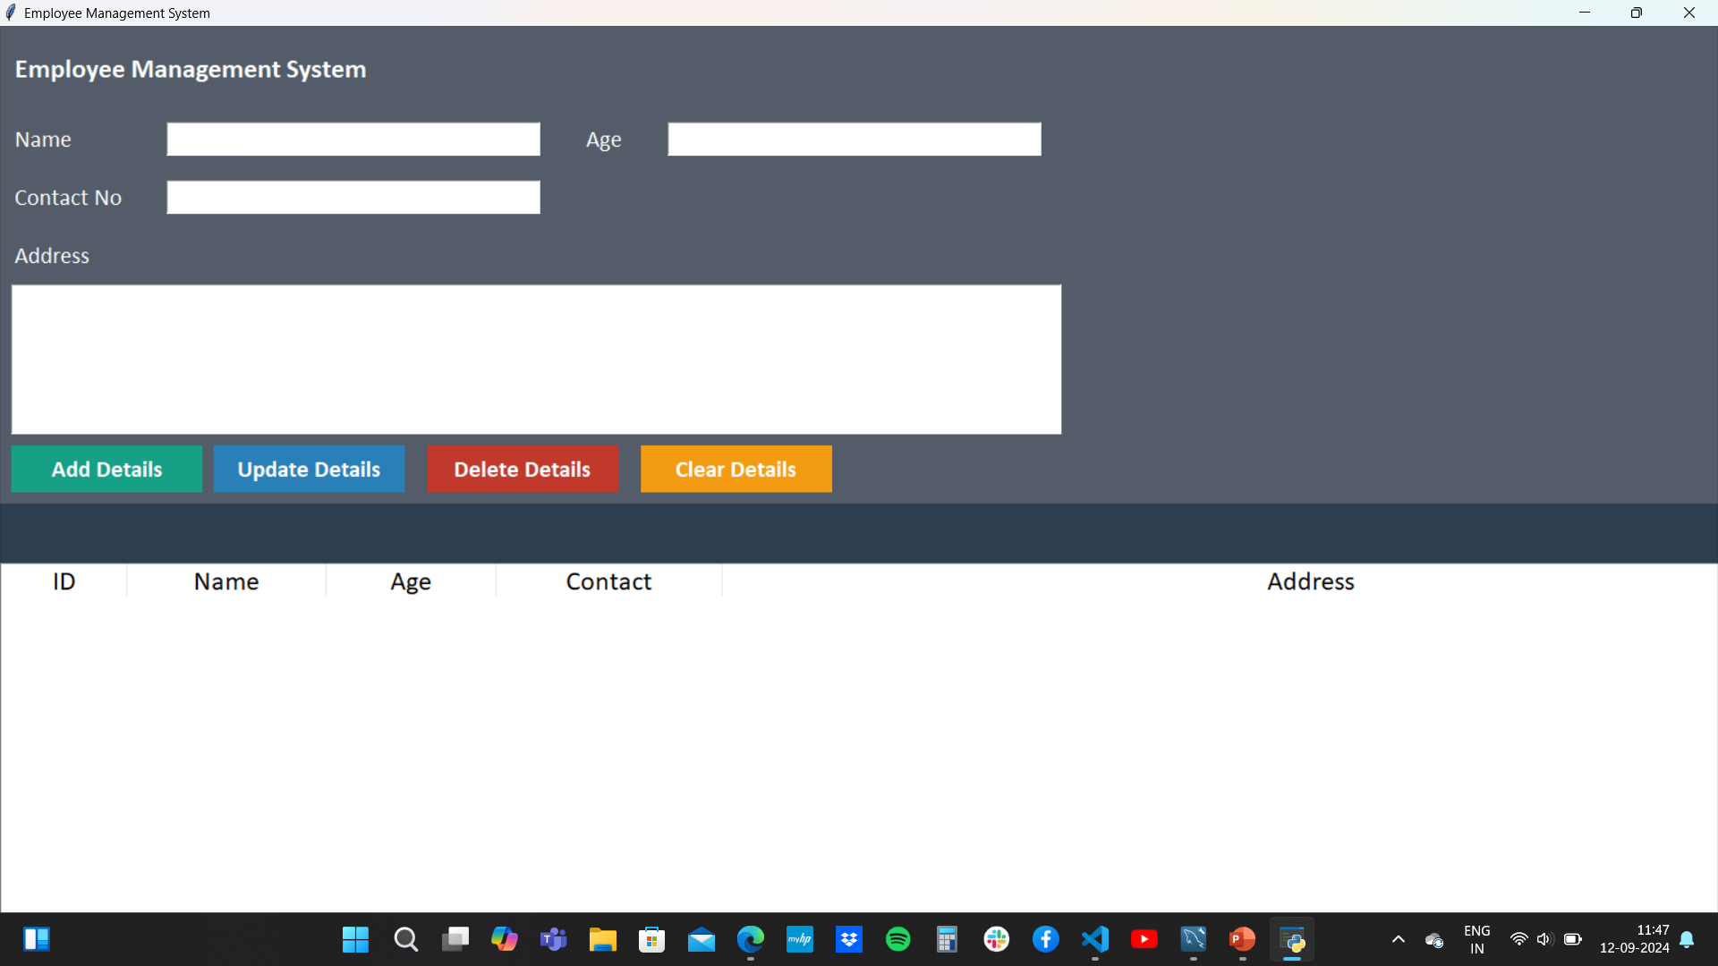

Slide 8
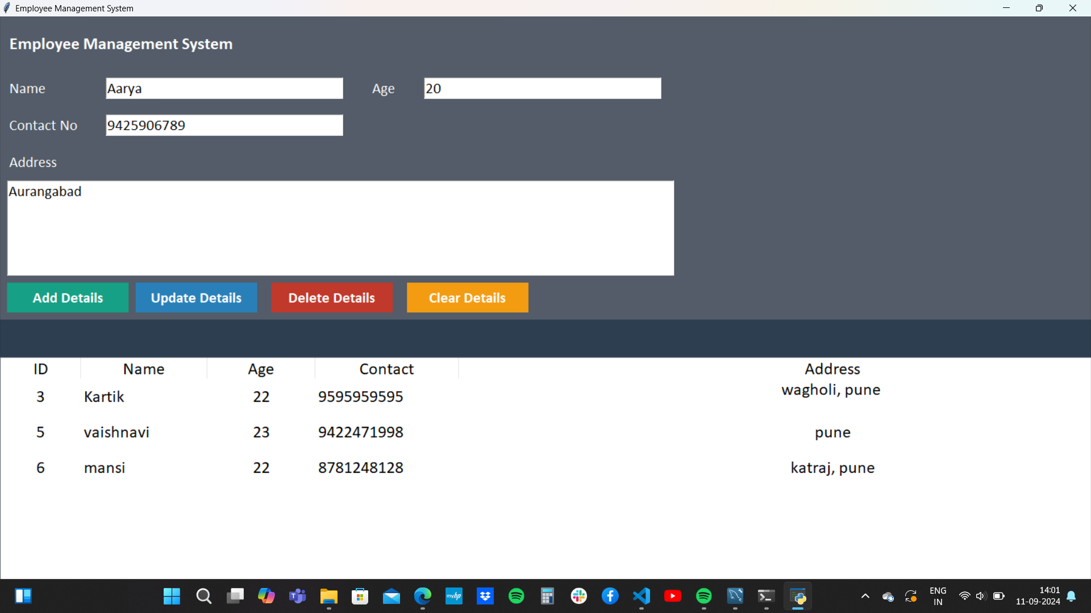
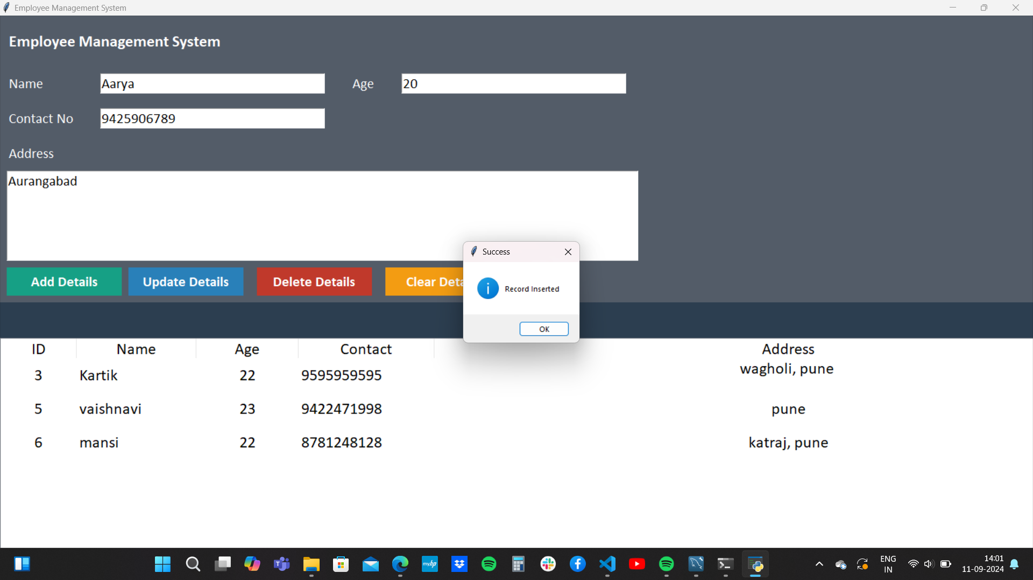

Slide 9
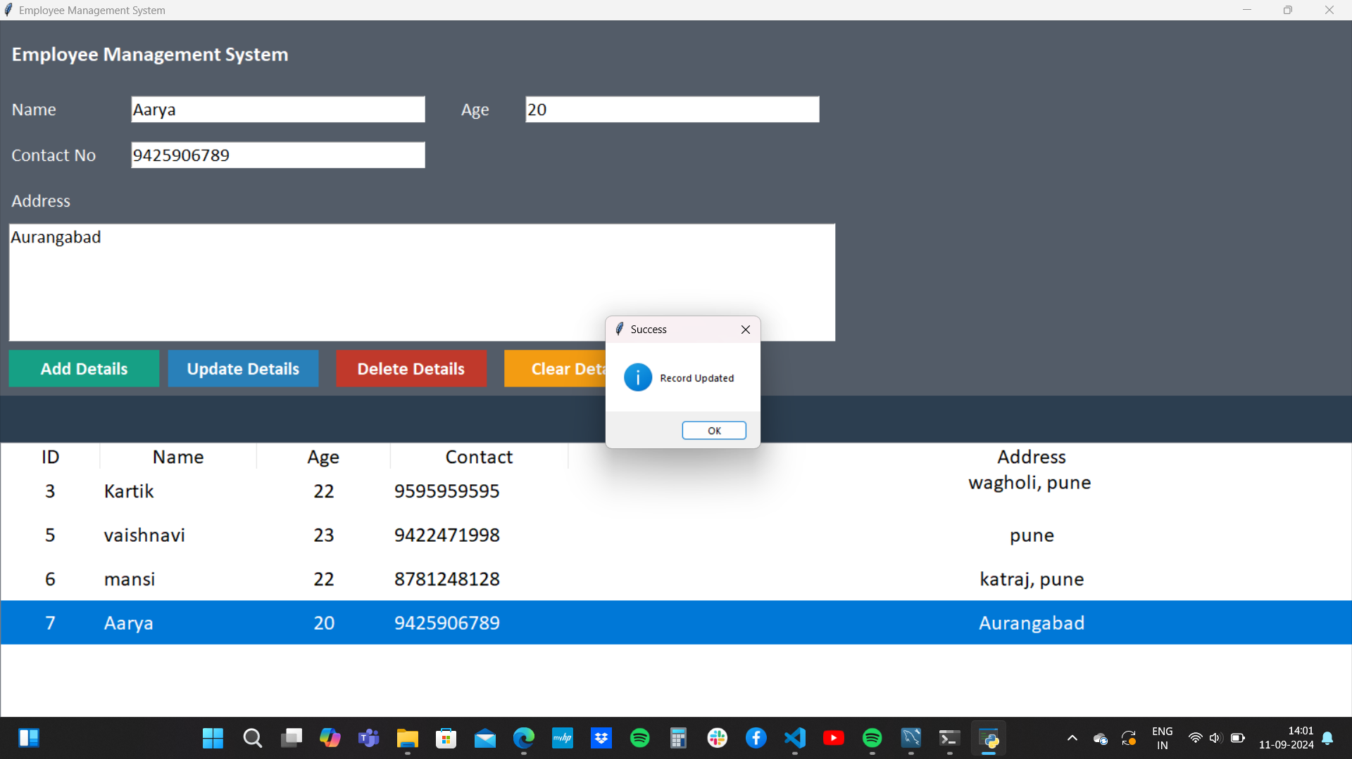

Slide 10
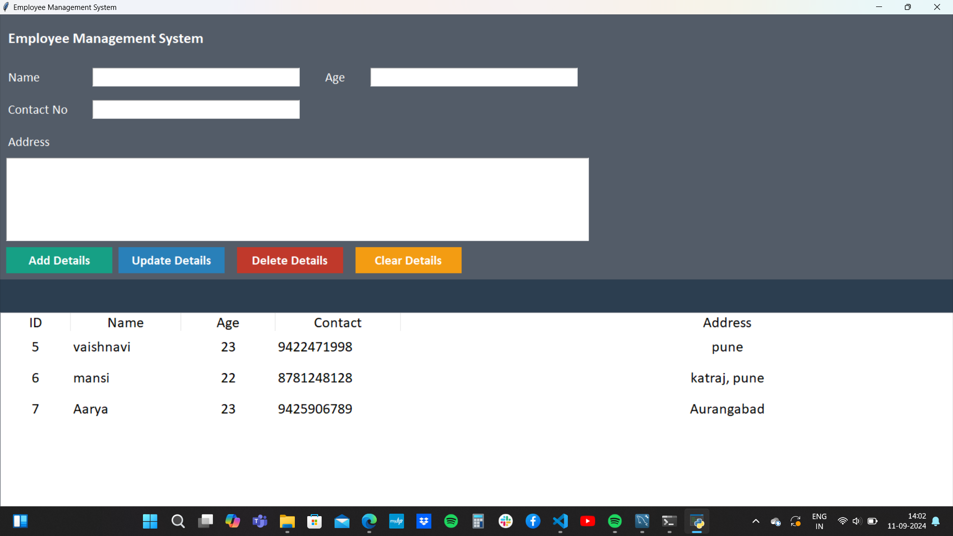

Slide 11
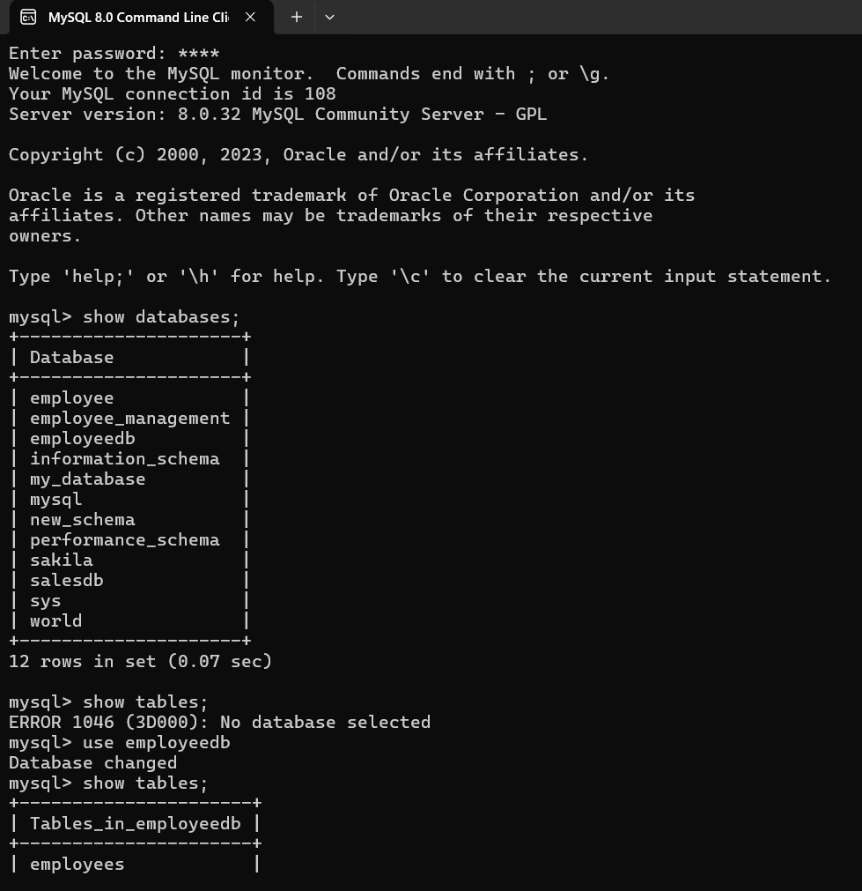
MySQL

Slide 12
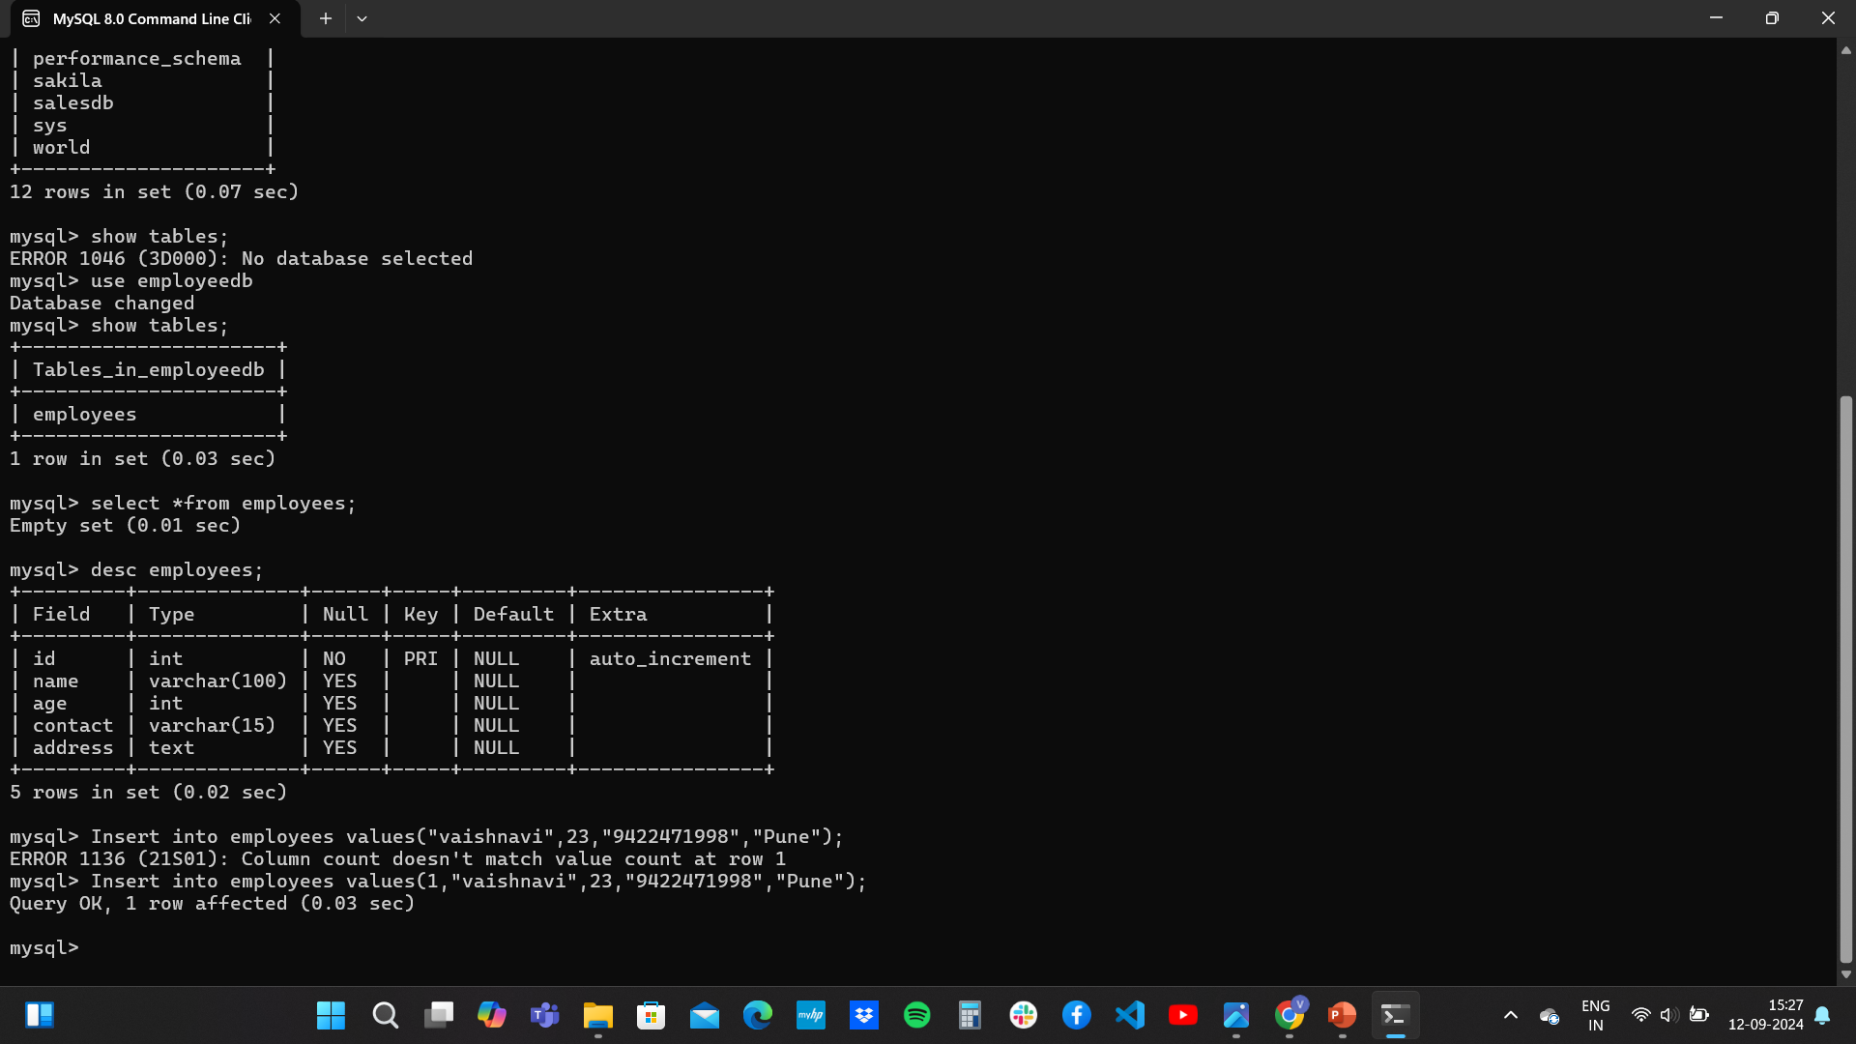

Slide 13
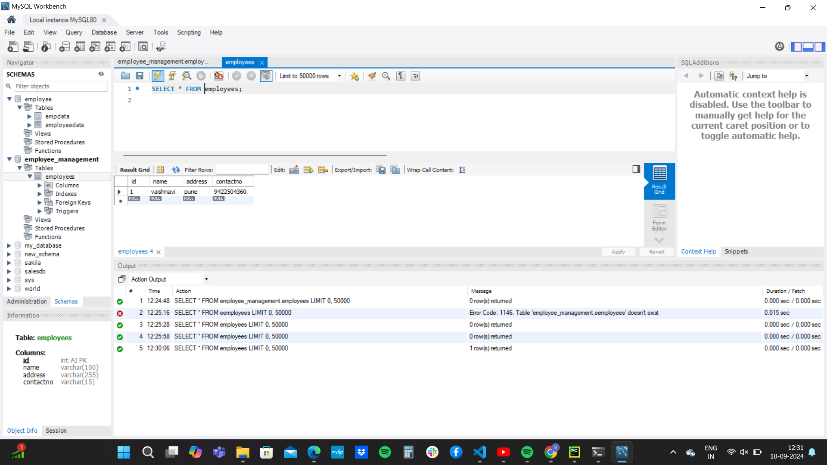

Slide 14
CONCLUSION
Proposed employee management system was successfully implemented.

